Slide 1

Boat Sales
Liao Jun Yang

Slide 2
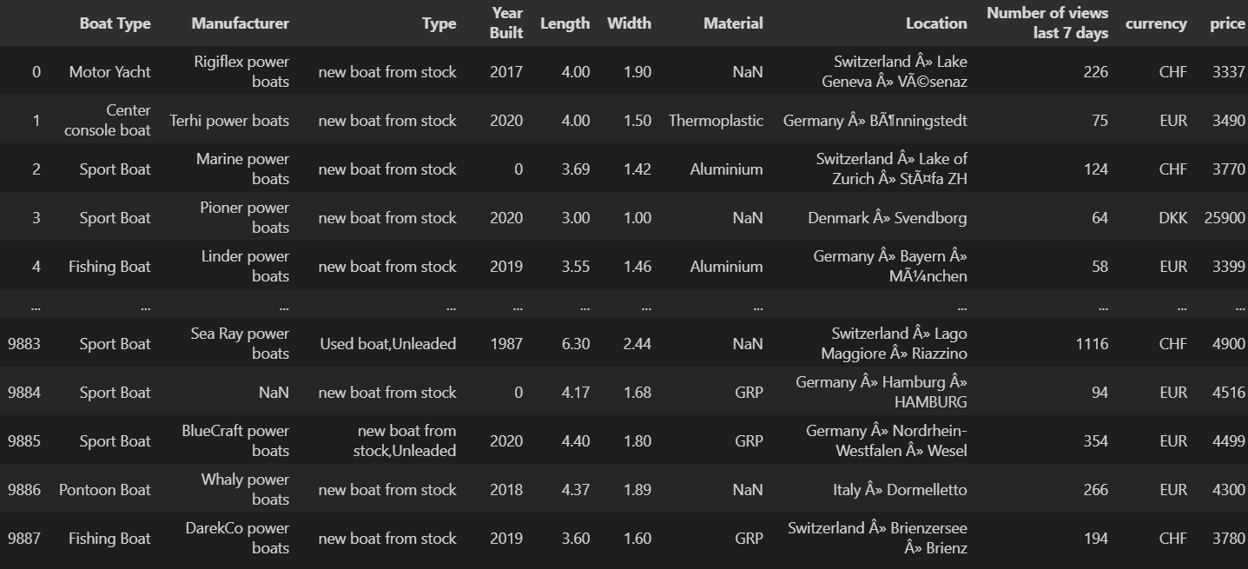
Agenda
Dataset Columns
Boat Type – The type of boat being listed
Manufacturer – The company which manufactured the boat
Type – Condition of boat, what type of fuel does it use
Year Built – The year which the boat was built
Length/Width – Length/Width of the boat
Material – The material used to make the boat
Location – Where the boat is located at
Number of views – The number of views the boat has on the website
Currency/Price – The currency/price of the boat
Background information
Correlation Heatmap
Data Insights
Recommendations

Slide 3
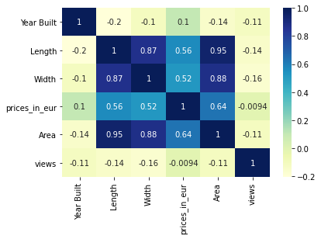
Heatmap
Heatmap shows the significance that each variable has on one another
Length, Year built, and Width does not have much significance on the number of views
Prices do not have much effect on the number of views!
However, we can see that the area of the boat has a strong effect on the price of the boat
Why is it that the prices do not affect the number of views?

Slide 4
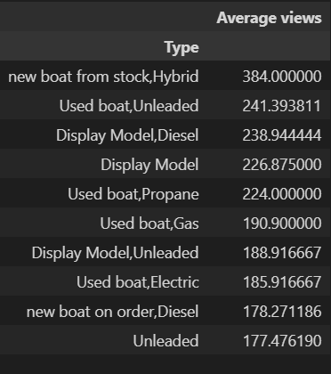
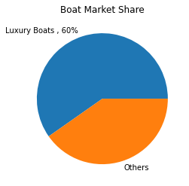
Data Insights
Luxury boats make up a huge part of the boat market
Main bulk of consumers in the boat market are the rich
The price of the boat is not an issue for them, hence why prices do not affect the views

Slide 5
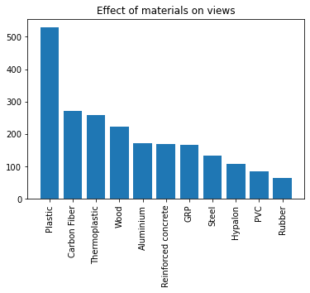
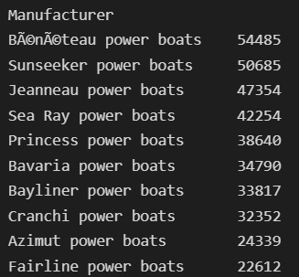
Additional Insights
Significant increase in views when plastic is used
Since plastic is used the most in the building of luxury boats
Manufacturers which bring in the greatest number of views are those who specialize in building luxury boats

Slide 6
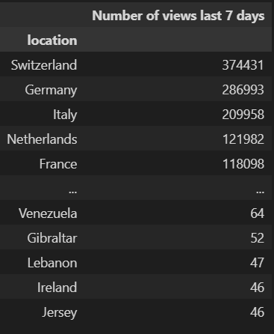
Data Insights
Location of the boat has an impact on the number of views a boat receives
Looking at the trend, we can see that the locations which are more popular are countries which compose a large number of rich people
Hence, we can conclude that rich people are more likely to buy boats that are in a location of convenience to them

Slide 7
Conclusions / Summary
Luxury Boats ( Motor Yacht etc.) appeal most to the people visiting the website
Boat Price does not have much significance on the number of views that a boat receives
Main bulk of people visiting the website are the rich or people with high-income
Boats that are in countries where people are more well-off are more popular

Slide 8
Recommendations
More emphasis on marketing luxury boats
Add on additional features on the boats which are targeted at the rich
Link the location of the boat to the scenery present in the location

